Slide 1
Learning for All
The challenges of change
March 2009
Ali Jarvis

Slide 2
“Learning for All”
– What do we really mean?
A set of longitudinal metrics and an action plan
A value base of foundational principles
A point of intersection
    Access and inclusion
    Equality and diversity
    Experience and attainment
    Ethos and organisation
    Individual and society
A journey of change

Slide 3
Progress towards a different future
What will our future look like if work done in this area is effective?
How do we keep hold of the overall vision whilst focusing on the concrete steps at a local level that get us there?
How can we ensure LfA remains a valuable tool for change?
Must be about outcomes and not activities
‘Joined-up’ and integrated actions at local, regional and national levels

Slide 4
Some concrete challenges
Constantly evolving gender issues
MCMC group - how aspiration and experience impact on achievement
Ethnicity in a time of rapidly changing demographics
Lifelong learning and workplace training
A difficult and uncertain economic climate

Slide 5
Transforming not Tinkering
The level of difficulty of the task related to the level of impact it has
Use ‘quick wins’ for early momentum but sustainable change needs transformative thinking
Personal challenge, group challenge (practitioners), collective challenge (society)
LfA helps the understanding but we have to deliver the remedies
Not just about doing things better but will have to be about doing things differently
The fact that it’s hard can not be our excuse
  Leadership, bravery and managing risk

Slide 6
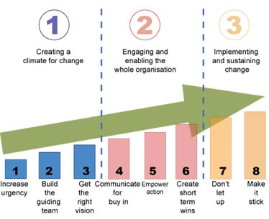
Learning for All = A change agenda
John Kotter – Harvard Business School

Slide 7
What does our future hold?
What may I, you and we all need to do differently ?
Am I, are you, are we all prepared and equipped for that ?
How do we embed this within our unconscious competence so that it moves from a ‘programme of activity’ to simply the normal way we do things?
“It is not because it is difficult that we do not dare
It is because we do not dare that it is difficult”
Seneca (4BC – AD65)

